Slide 1
Plagiarism in Written Works
Disampaikan oleh:
Tim Pengajar MPPI

Slide 2
What is Plagiarism?
Source:
http://www.plagiarism.org/plagiarism-101/what-is-plagiarism/
http://www.plagiarism.org/ask-the-experts/faq/

Slide 3
Definition of “Plagiarize”
Based on Merriam-Webster Online Dictionary:
To steal and pass off (the ideas or words of another) as one’s own
To use (another’s production) without crediting the source
To commit literary theft
To present as new and original an idea or product derived from an existing source
Fraud (stealing others’ work + lying about it)
Violates copyright laws
Not tolerated in academic environment

Slide 4
Copyright Laws
Made to protect intellectual integrity
Includes variety of media: music, images, written words, video, etc.
Violation can be prosecuted

Slide 5
Works Without Copyright
Compilations of readily available information
Phone book
Facts that are not the result of original research
Carrot contains Vitamin A, number of province in Indonesia
Public Domain
Works no longer (or never been) protected by copyright
Still needs proper attribution

Slide 6
Types of Plagiarism in Written Works
Source:
http://www.turnitin.com/assets/en_us/media/plagiarism_spectrum.php
http://go.turnitin.com/paper/plagiarism-spectrum

Slide 7
Plagiarism Spectrum
Proposed by Turnitin, web-based solution for plagiarism prevention, in 2012
Based on worldwide survey of 879 respondents (secondary and higher education instructor)
Defined 10 types of unoriginal work and ranked it by frequency, problematic, and severity
Explained in common words to make it easier to understand

Slide 8
Clone
An act of submitting another’s work, word-for-word, as one’s own

Slide 9
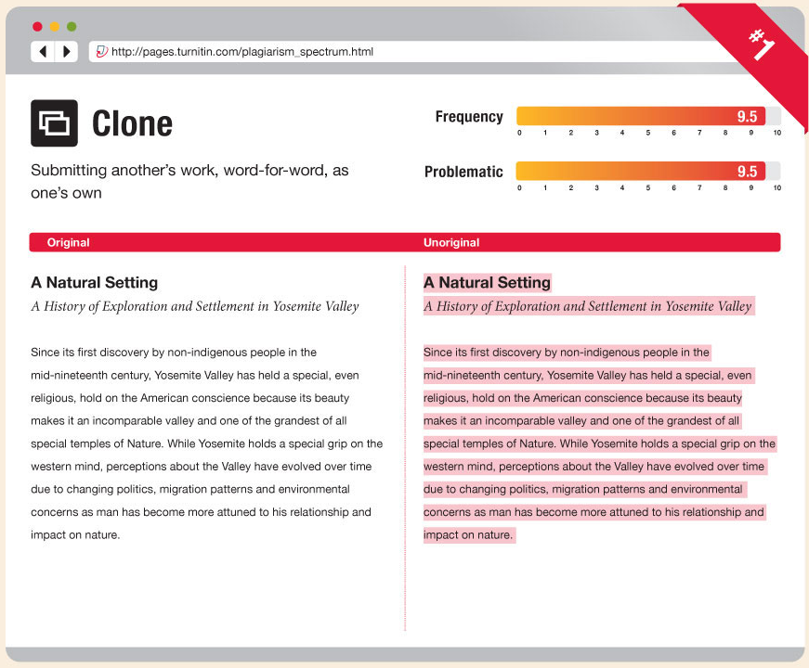

Slide 10
Ctrl-C
A written piece that contains significant portions of text from a single source without alterations

Slide 11
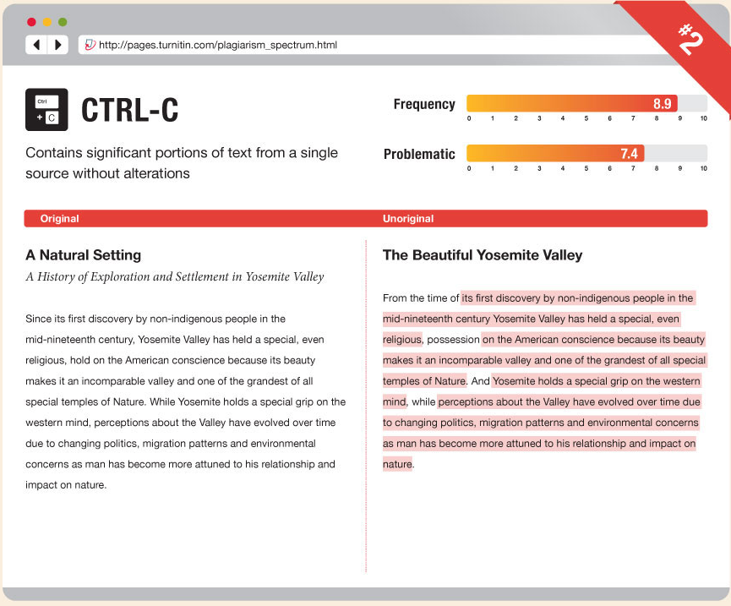

Slide 12
Find-Replace
Act of changing key words and phrases but retaining the essential content of he source in a paper

Slide 13
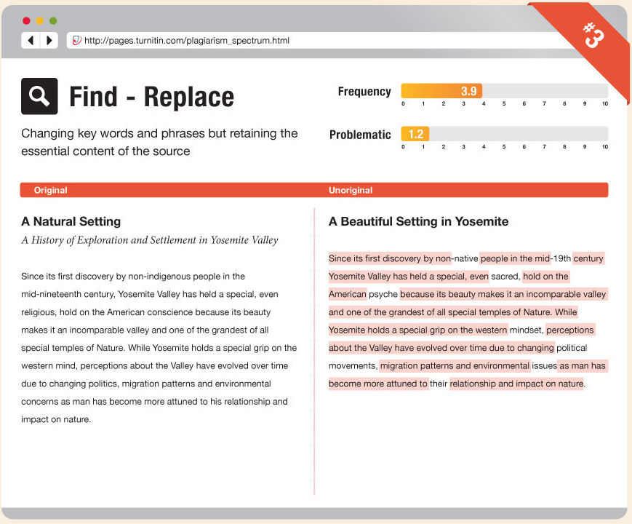

Slide 14
Remix
Act of paraphrasing from other sources and making the content fit together seamlessly
Paraphrasing: restatement of a text or passage in other words

Slide 15
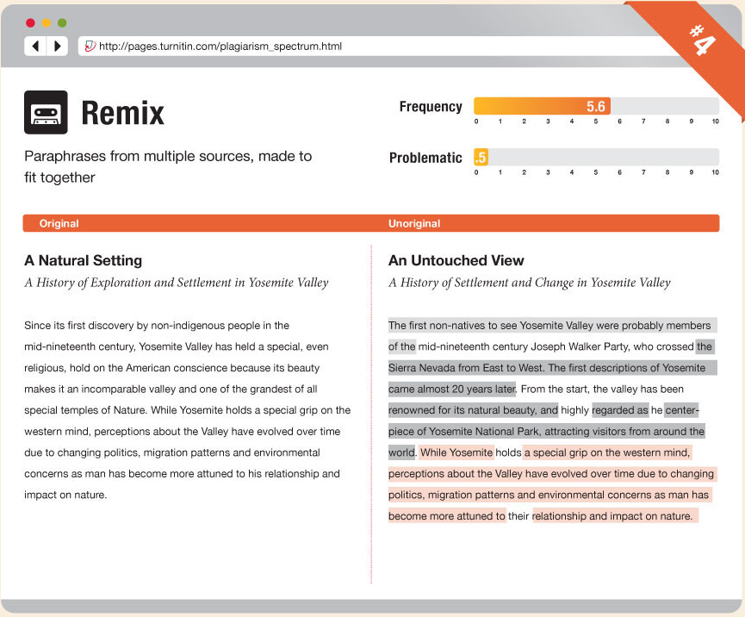

Slide 16
Recycle
Act of borrowing generously from one’s own previous work without citation
Also known as self-plagiarism

Slide 17
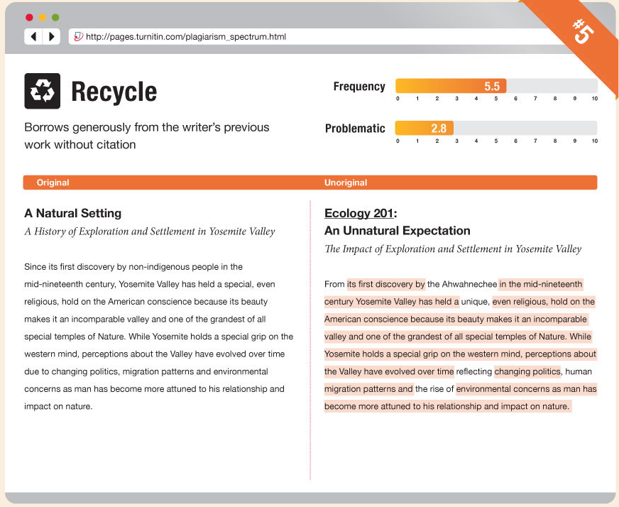

Slide 18
Hybrid
Act of combining perfectly cited sources with copied passages, which are without citation, in one paper

Slide 19
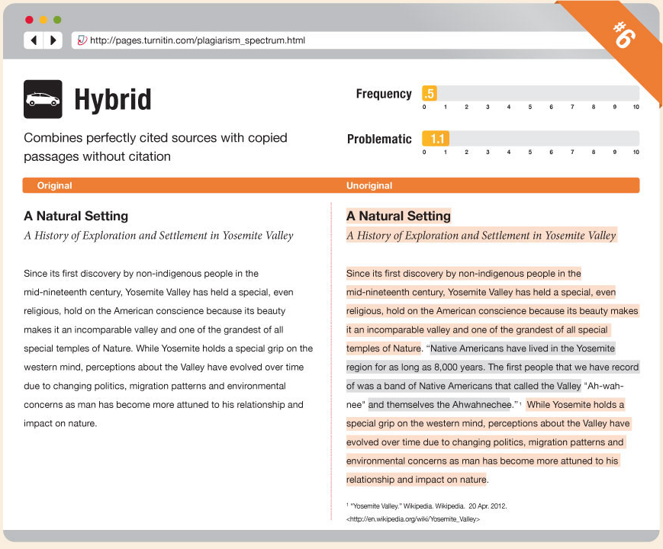

Slide 20
Mashup
Paper that represents a mix of copied material from several different sources without proper citation

Slide 21
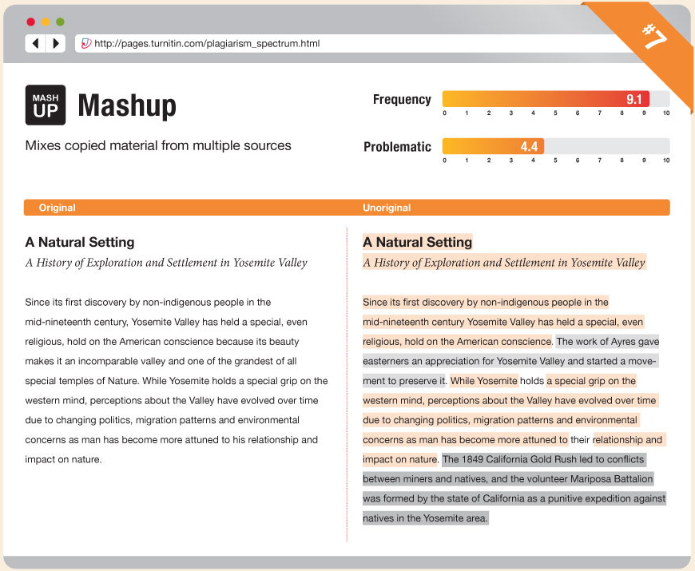

Slide 22
404 Error
A written piece that includes citations to non-existent or inaccurate information about sources

Slide 23
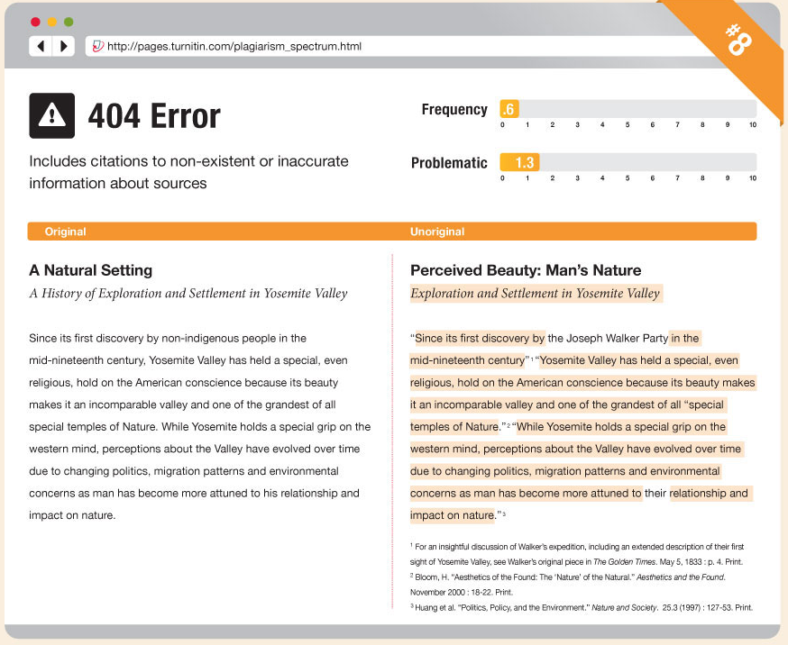

Slide 24
Aggregator
A paper which includes proper citation but contains almost no original work

Slide 25
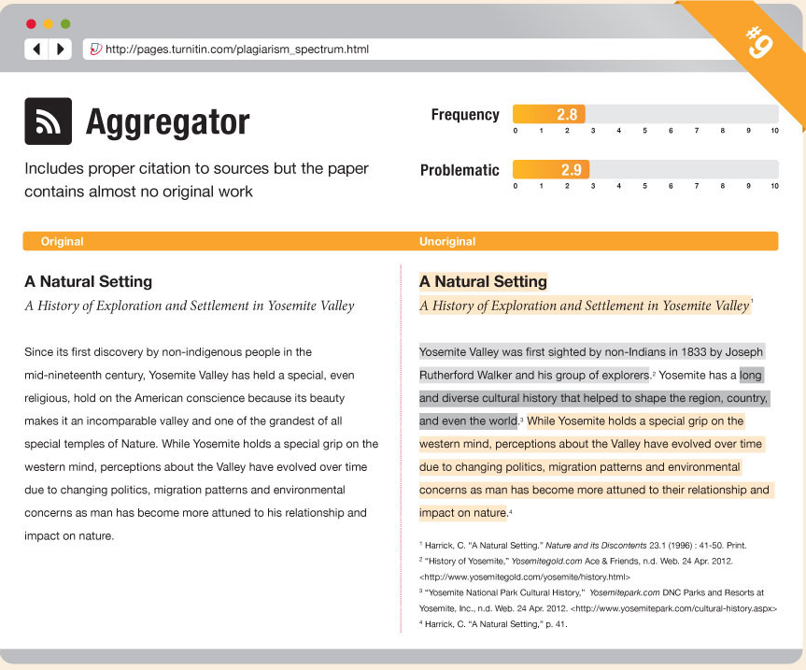

Slide 26
Re-tweet
A paper which includes proper citation, but relies too closely on the text’s original wording and/or structure

Slide 27
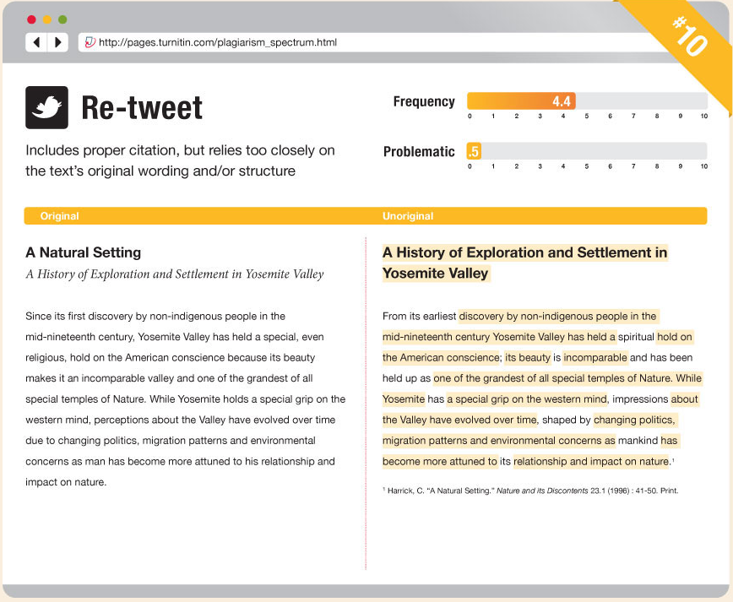

Slide 28
Severity Rank
Based on intentionality
From most severe to least severe
Clone
Ctrl-C
Find-Replace
Remix
Recycle
Hybrid
Mashup
404 Error
Aggregator
Re-Tweet

Slide 29
Frequency Score
Frequency of types in survey

Slide 30
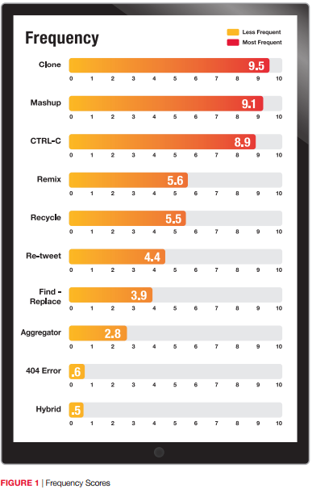

Slide 31
Problematic Score
“… their high problematic rankings reinforce the seriousness of the intent behind the plagiarism, but also underscore the challenge that educators encounter in identifying this type.”

Slide 32
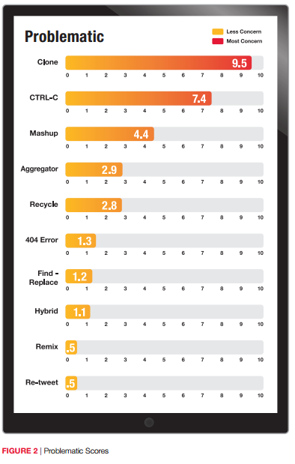

Slide 33
Preventing Plagiarism in Written Works
Source:
http://www.plagiarism.org/plagiarism-101/prevention/

Slide 34
Prevention
During Planning
During Writing
Consult with instructor
Plan the paper
Take effective notes
When in doubt, cite sources
Make it clear who said what
Know how to paraphrase
Analyze and evaluate sources

Slide 35
Will Citing Weakens My Paper?
May think that citing weakens paper, making it seems there are less original ideas
Citing actually strengthen by:
showing that you are not just copying other ideas but are processing and adding to them
lending outside support to the ideas that are completely yours
highlighting the originality of your ideas by making clear distinctions between them and ideas you have gotten elsewhere

Slide 36
Questions and answers session

